Slide 1
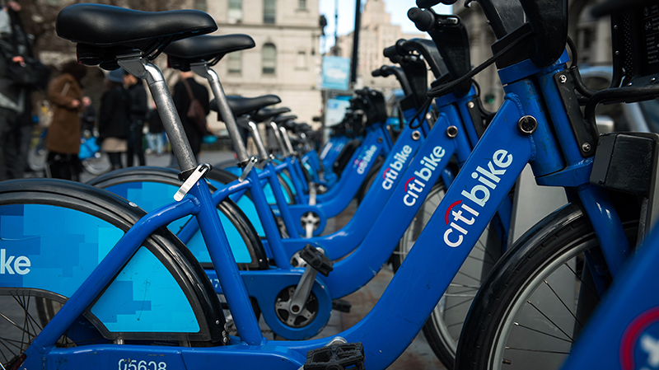
Citi Bike Trips August 2023
Elizabeth Chase
Python for Data Analytics

Slide 2
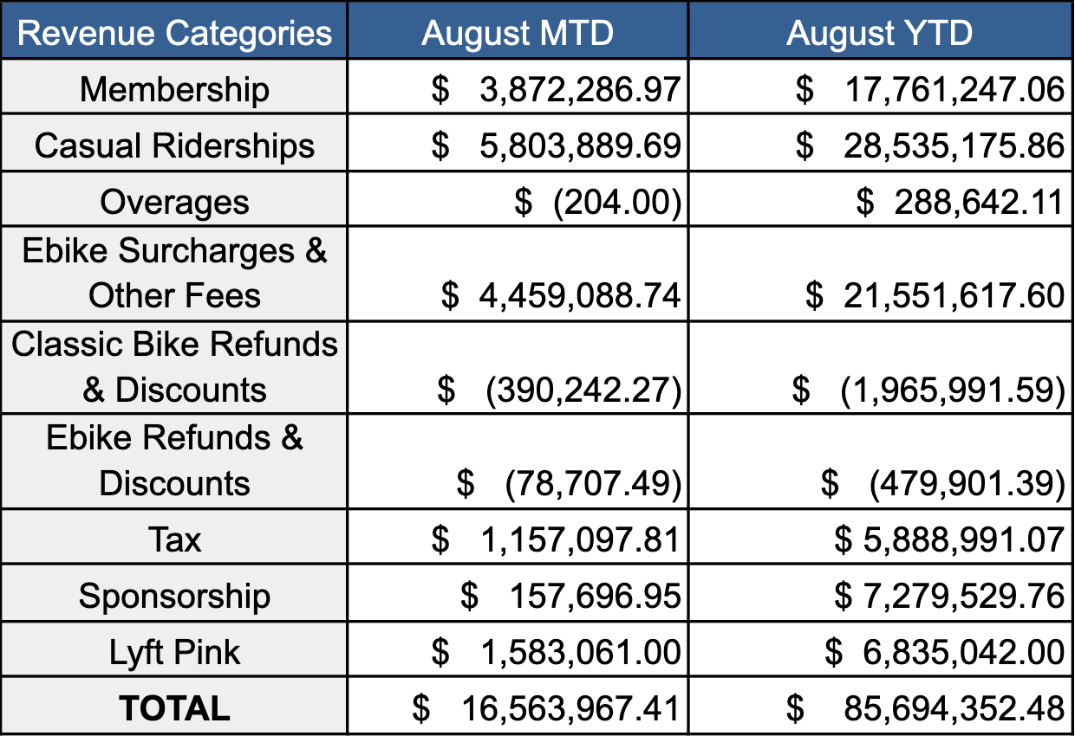
Background
20,000 regular bikes and 4,000 e-bikes
1,899 docking stations
130,000 active members
Revenue from casual riders and e-bike surcharges surpass membership fees

Slide 3
Research Questions
What is the breakdown of member vs casual rides?
What are the most common trips for each group? What can we infer from the types of trips users are taking?

Slide 4
Methodology
Citi Bike ride data set for August 2023 with over 4 million rows
Monthly data set with most rides in 2023
Filtered data into separate sets for members and casual riders
Python Libraries: Pandas, Matplotlib, Seaborn
Used value counts function to find most common station pairs

Slide 5
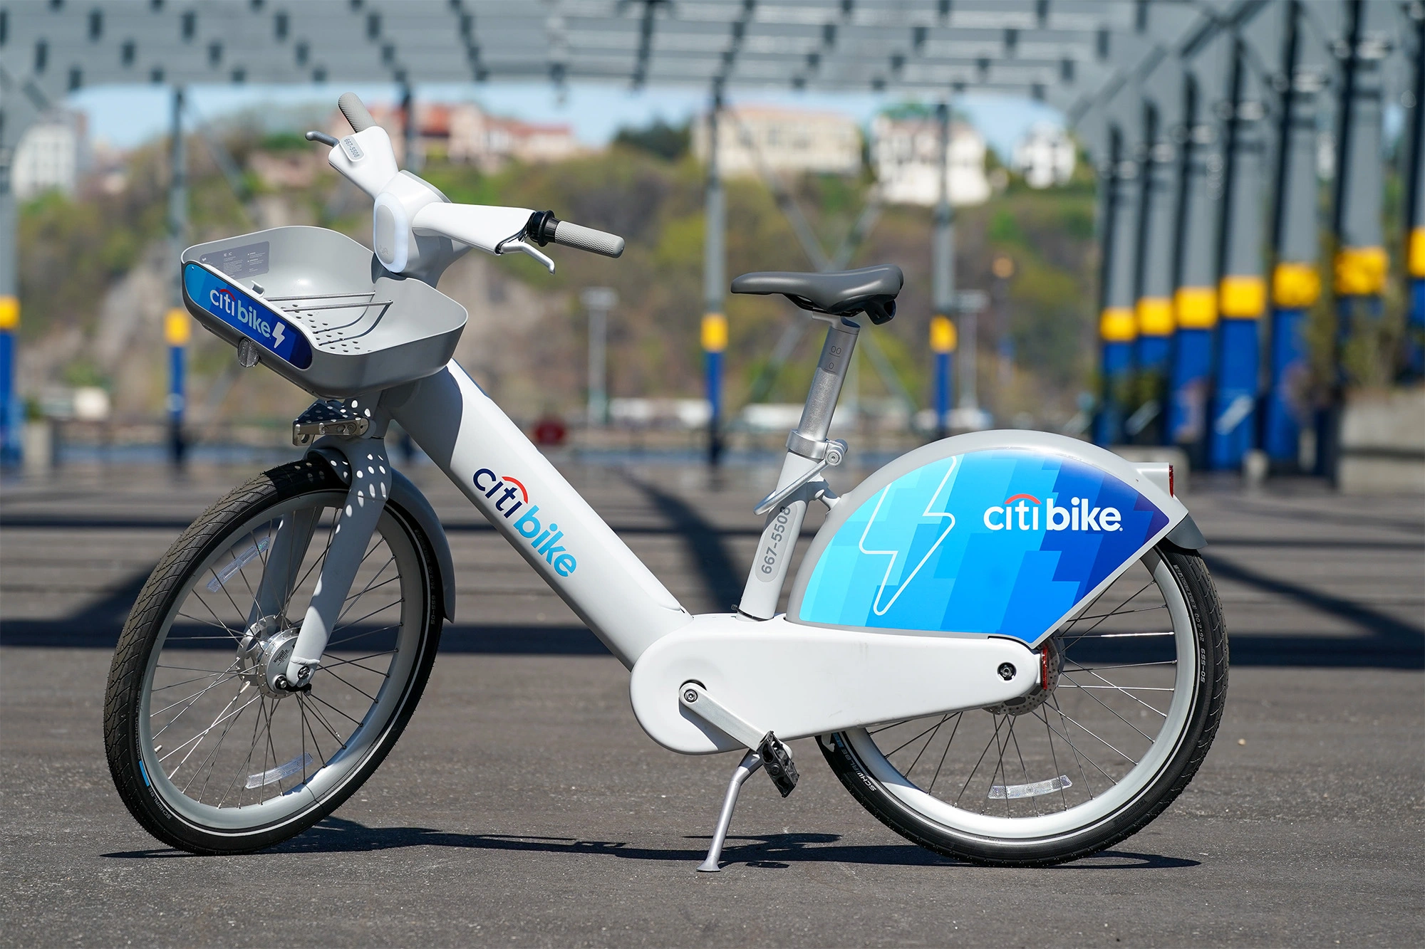
Findings
4,093,169 individual rides taken in August
22% casual riders and 78% member riders
7.5% of all rides on e-bike
Casual riders used e-bike 8.35% (73,980 rides)
Members used e-bike 7.35% (233,981 rides)

Slide 6
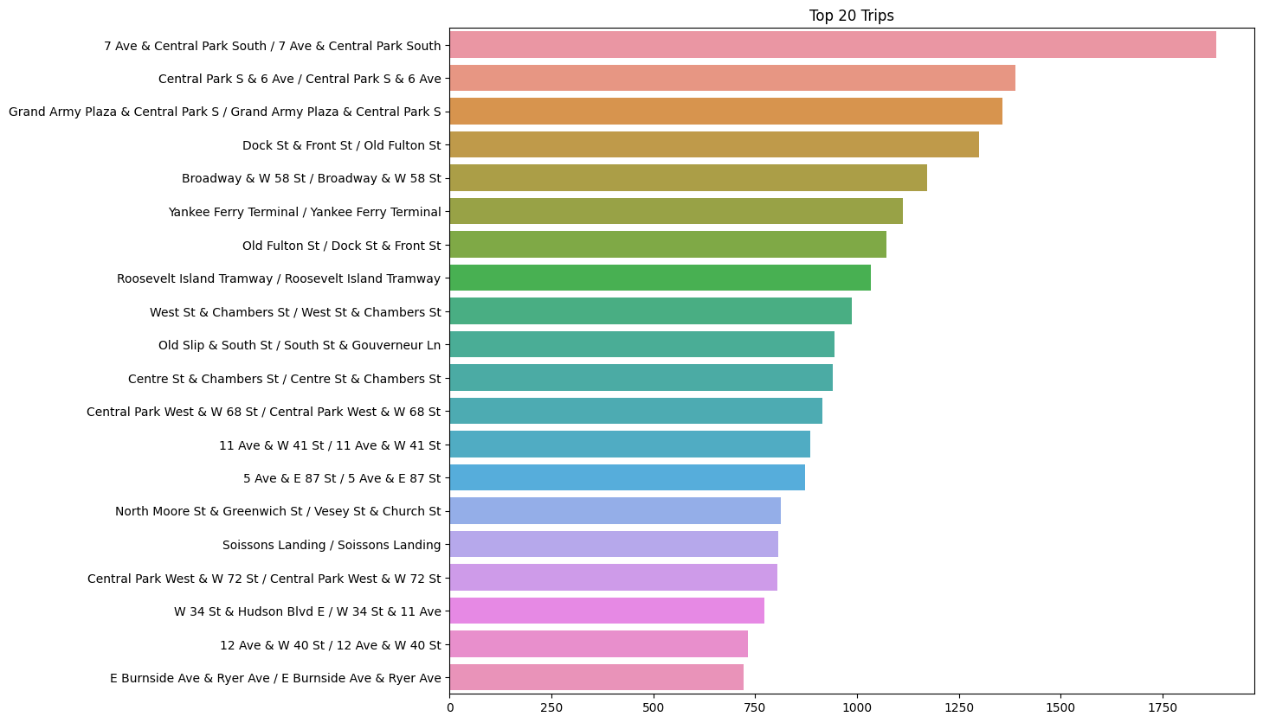
Trip Analysis
612,721 unique trips taken
15 of top 20 trips start and end at the same station (loop trips)
Many of these stations are near parks or popular tourist areas - Central Park, Governor’s Island, Downtown Brooklyn

Slide 7
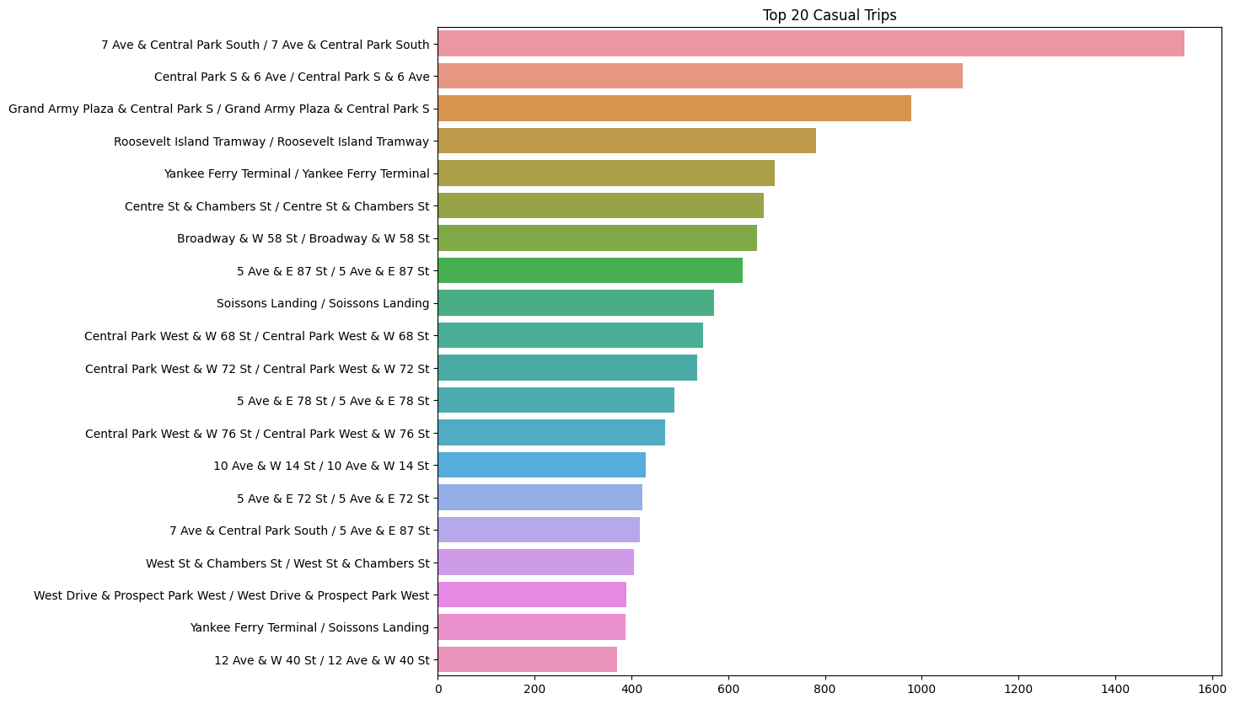
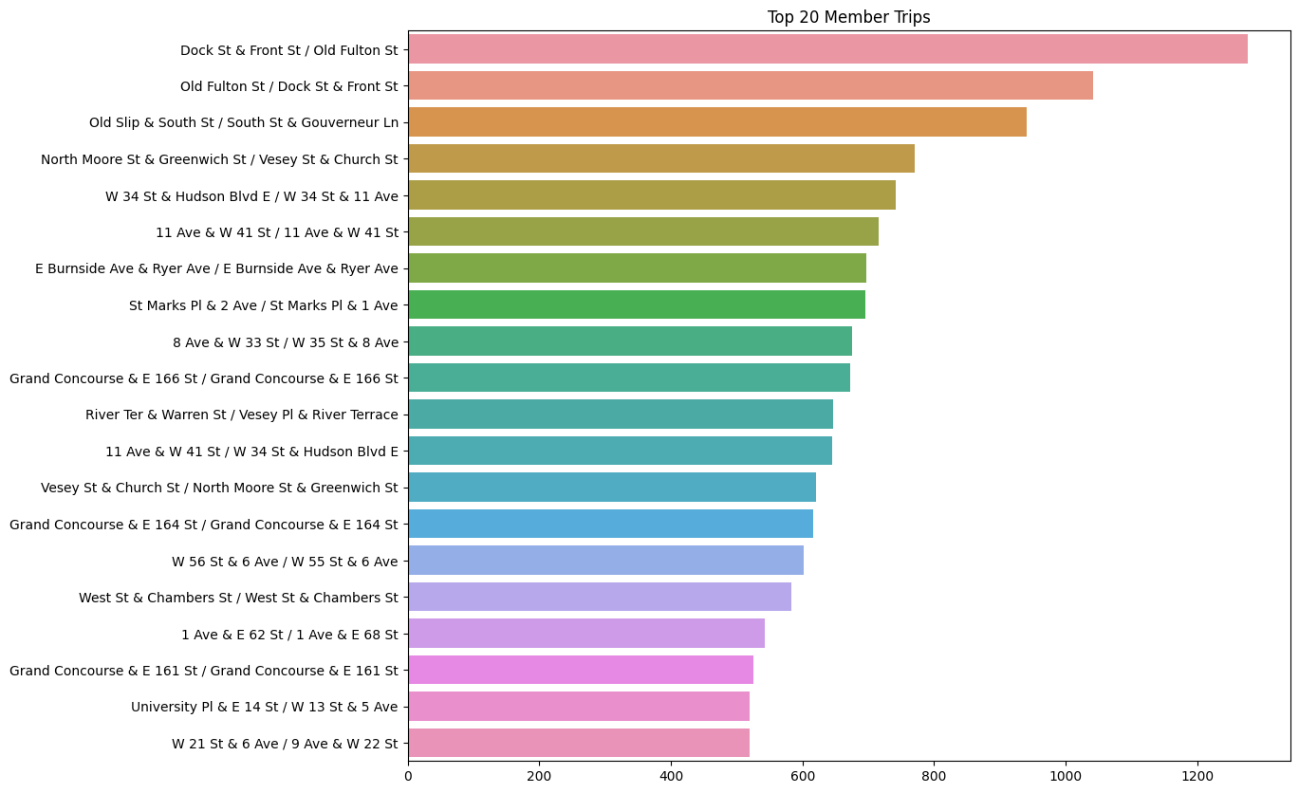
Trip Analysis – By Group
Casual riders take most loop trips - are likely using Citi Bike for recreation in parks and tourist areas
Members take mostly one-way trips - are transportation focused

Slide 8
References
https://s3.amazonaws.com/tripdata/index.html
https://ride.citibikenyc.com/blog/100million
https://help.citibikenyc.com/hc/en-us/articles/360039406631-Riding-with-an-ebike
https://mot-marketing-whitelabel-prod.s3.amazonaws.com/nyc/August-2023-Citi-Bike-Monthly-Report.pdf
https://citibikenyc.com/pricing
https://ny1.com/nyc/all-boroughs/transit/2023/05/26/citi-bikes-celebrates-10-years-in-new-york-city
https://www.statology.org/pandas-count-unique-combinations-of-two-columns/

